Slide 1
Lightning Talk: Data Security

Slide 2
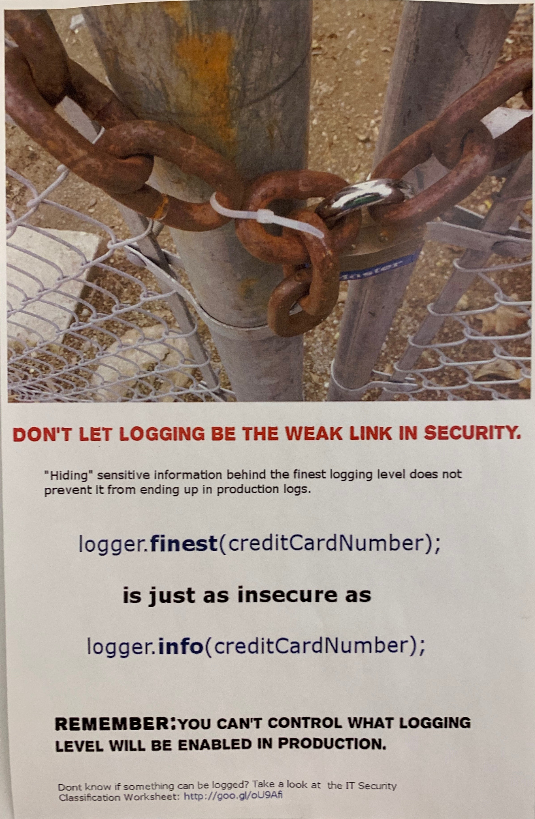
Importance Of Data Security
Poster At Gap
Notes:
Example of a poster at Gap Inc reminding developers about the dangers of logging user data.

Slide 3
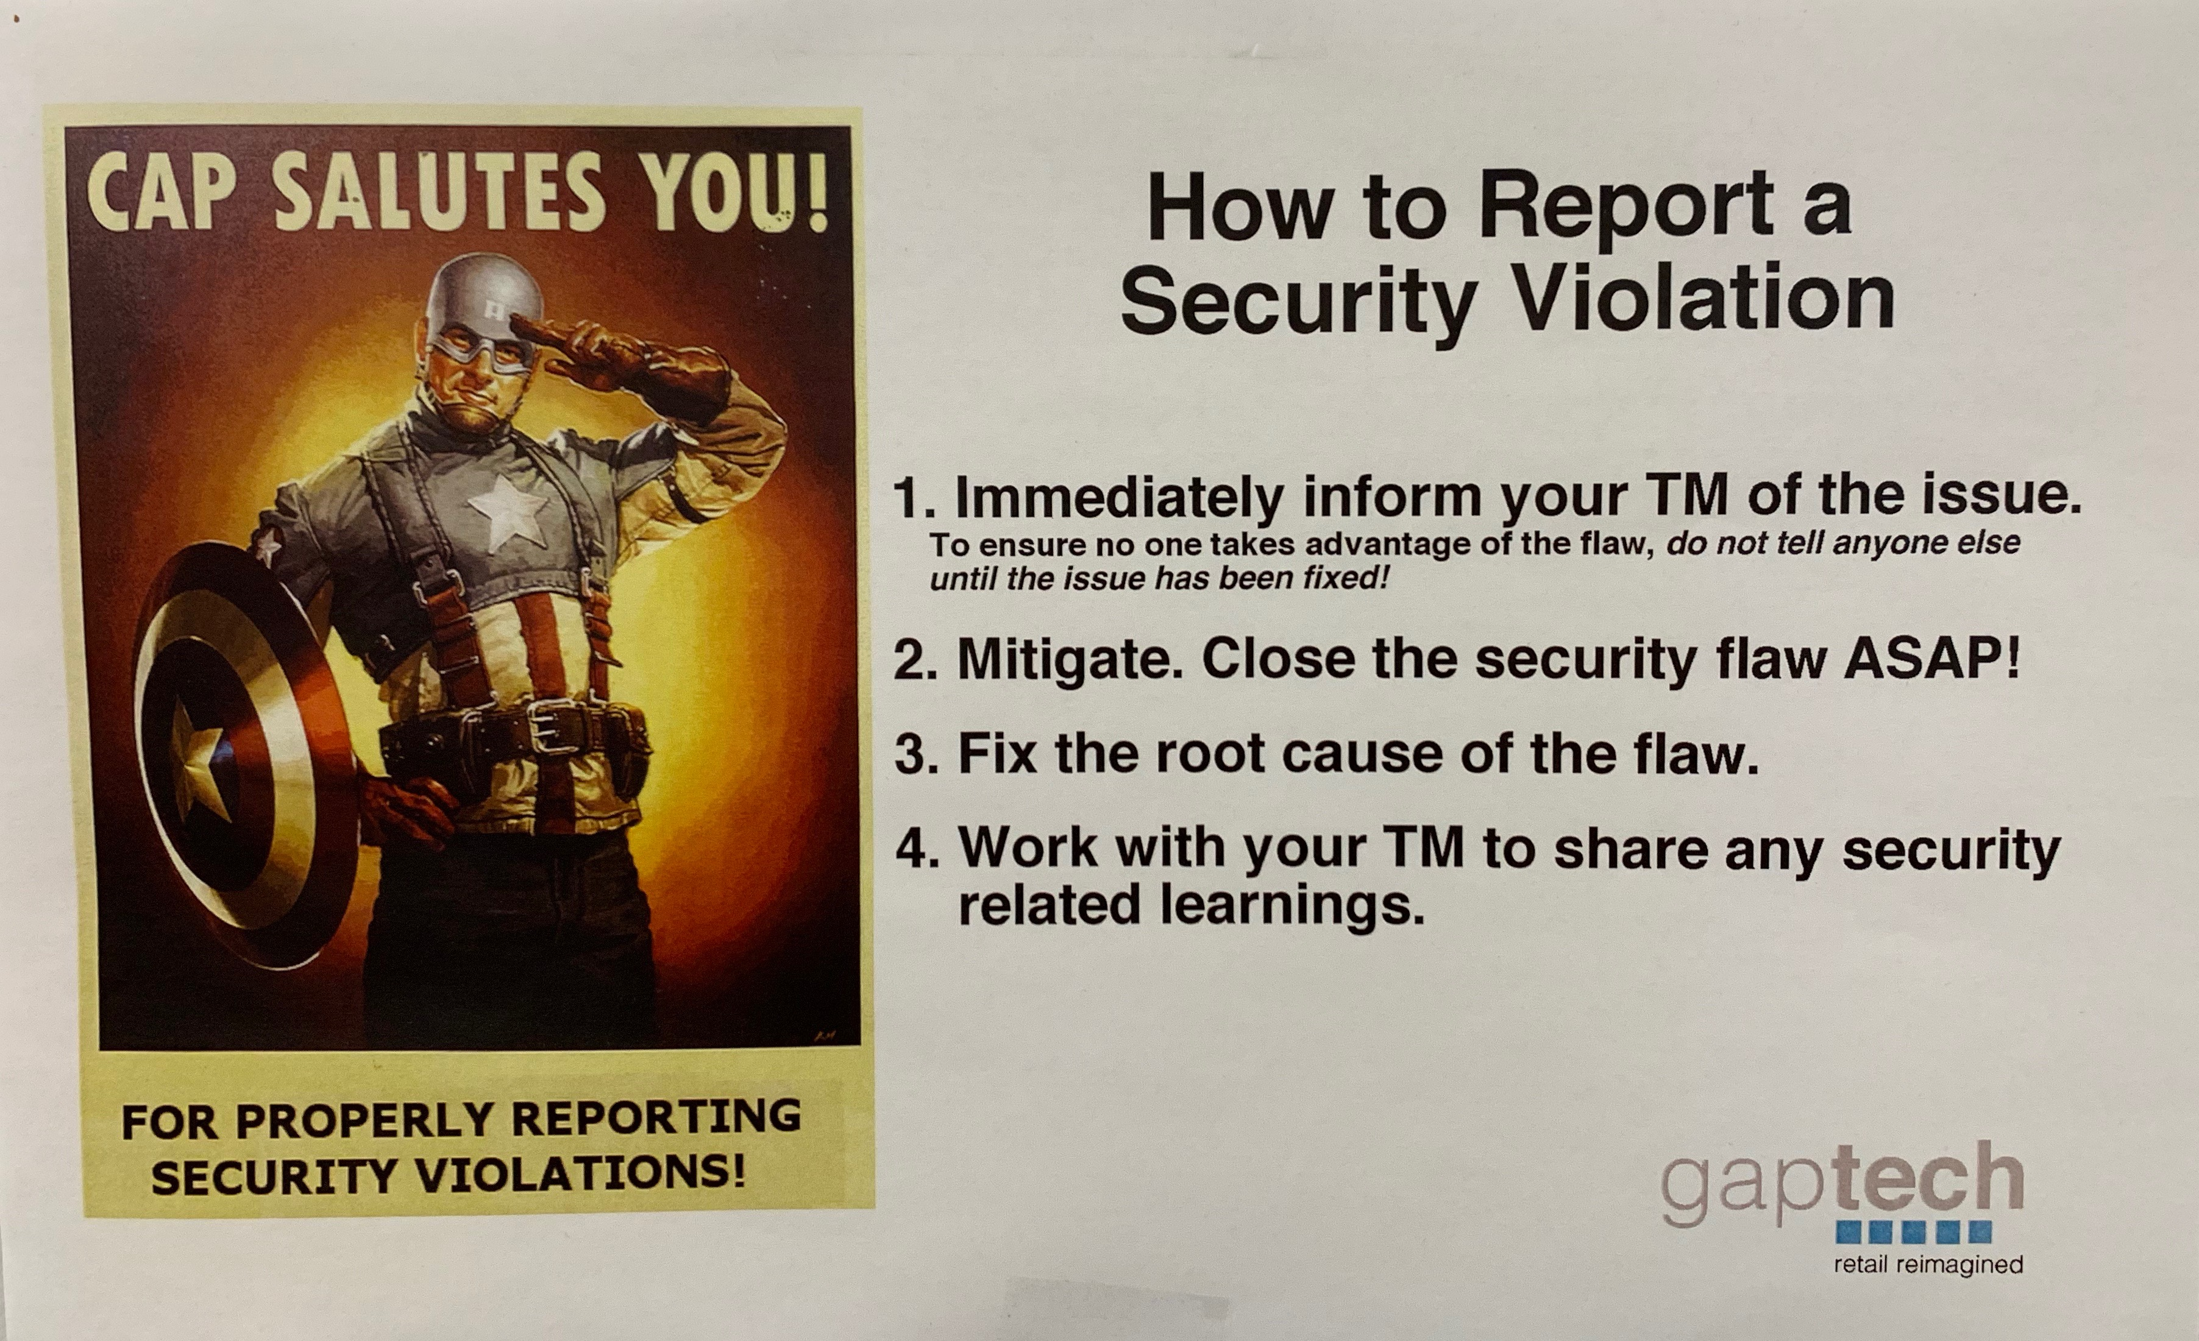
Importance Of Data Security
Poster At Gap
Notes:
Another sign at Gap Inc. Employees and contractors are required to complete an online course about data security once every year.

Slide 4
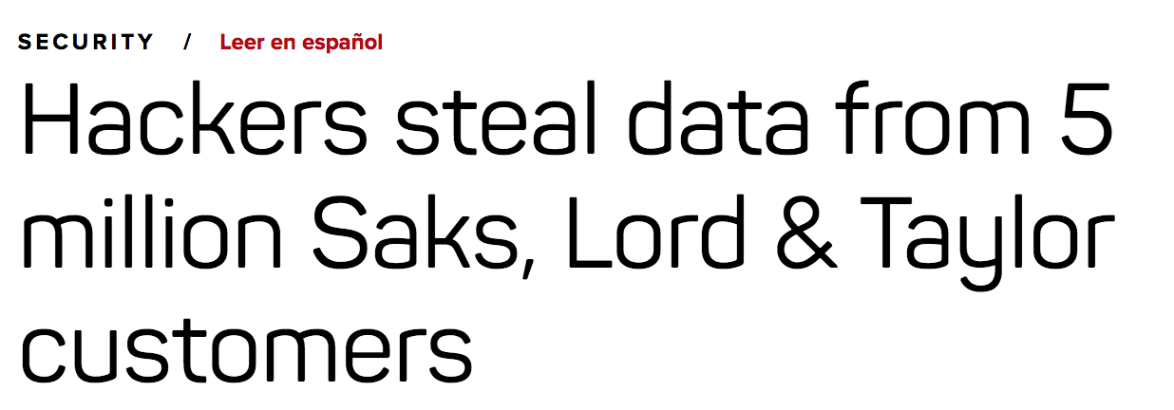
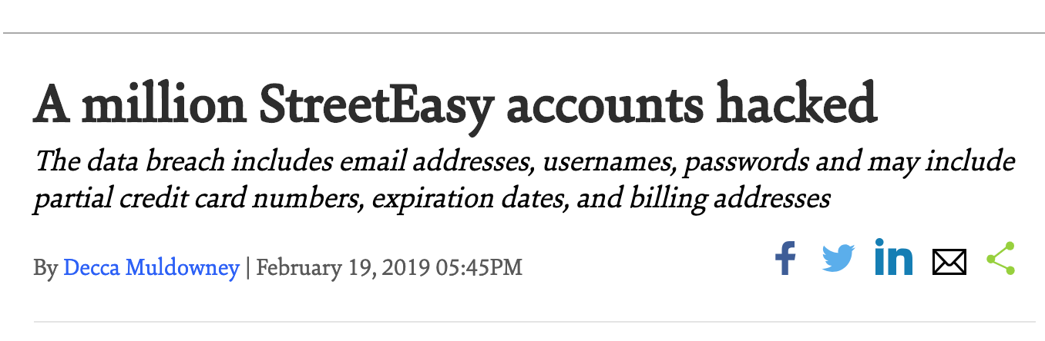
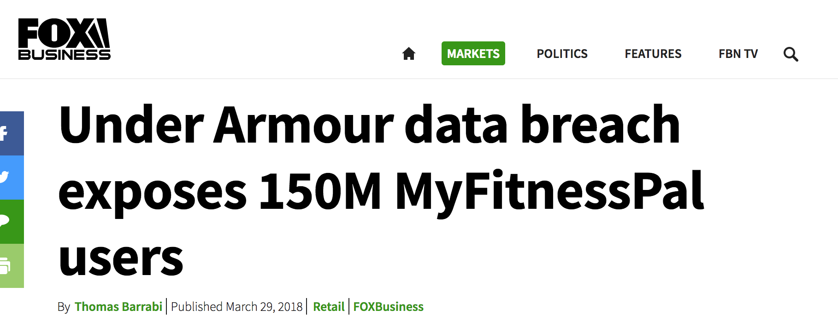
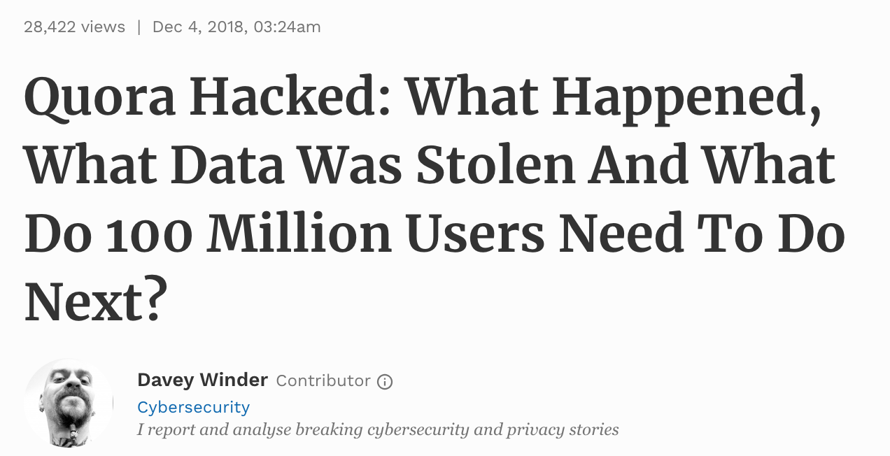
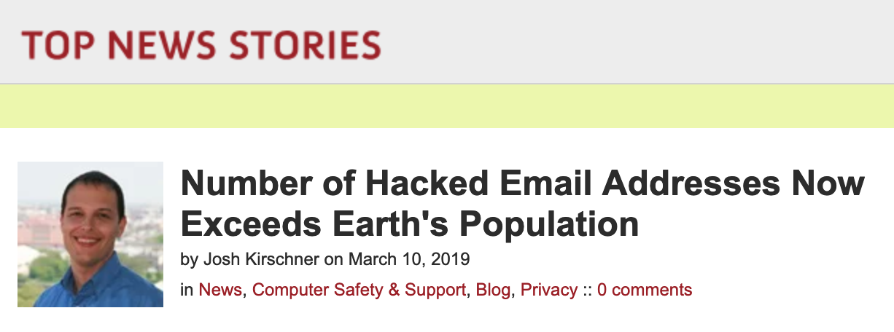
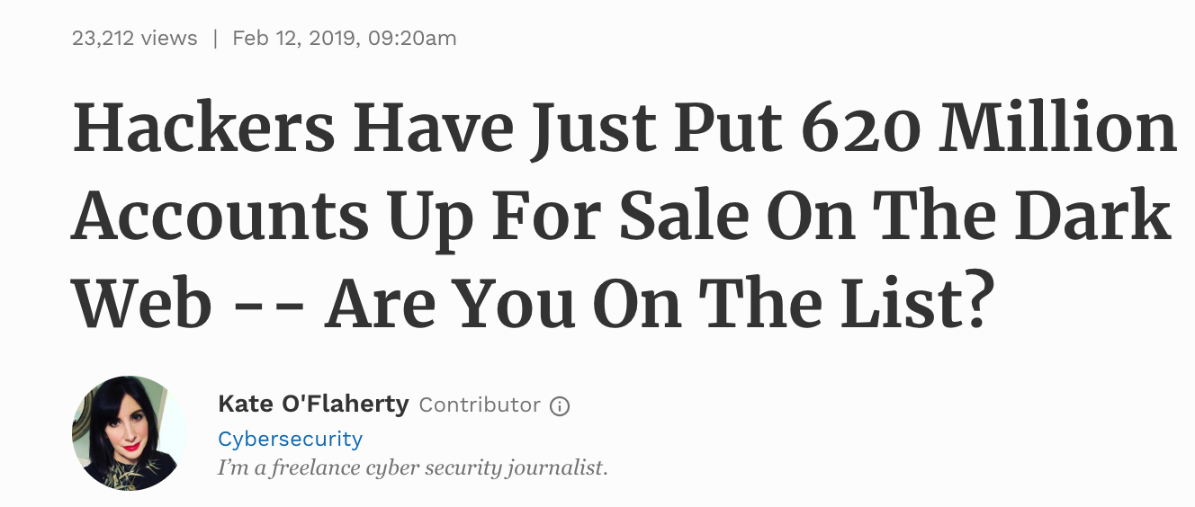
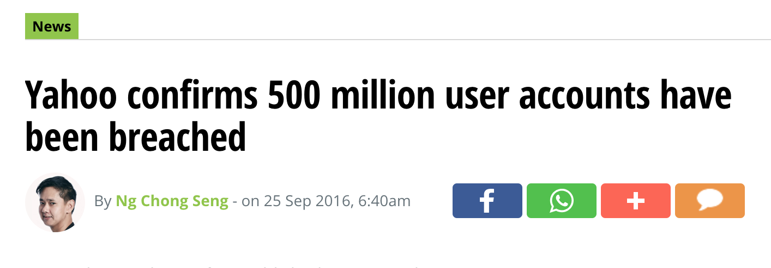
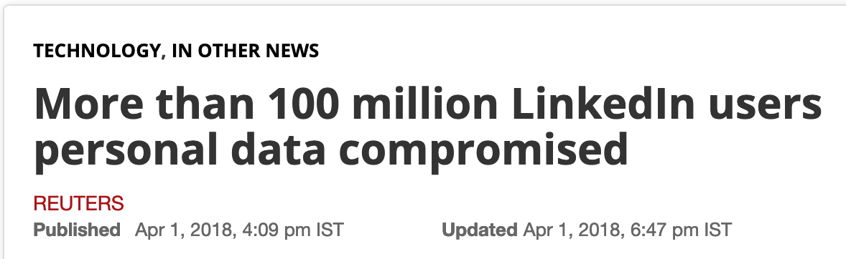
Headlines…
Notes:
We’ve all seen the headlines. Data breaches are big news and, sadly, too common.

Slide 5
Data Protection
Users
Need to educate themselves on how to protect access to their accounts.
Developers
Need to use good UX to guide users into making good decisions.
Need to use best practices to protect our user’s accounts.
Need to mitigate damage in the event data is compromised.
Notes:
Users need to take some responsibility to educate themselves on how to secure access to their accounts. We’ll get to a few suggestions in a second.
As developers, we can nudge users to make better decisions by:
Enforcing a minimum pw length
Displaying a “password strength” meter
Display checkboxes that turn green as the user uses combinations of numbers, symbols, and mixed case characters.
We use best practices on storing user data. More on that in a minute
And we need to quickly respond to vulnerabilities when they are discovered. Contacting users and forcing password resets, for example.

Slide 6
Steps Users Can Take To Protect Themselves
Use “Strong” passwords.
Use a different password on each site.
Don’t write them down.
Don’t share your password.
Consider using a password manager (1Password, Dashlane, LastPass, etc.).
Change passwords regularly.
Use MFA when possible.
Use Biometrics when possible.
Update your software.
Notes:
Here are some steps we as users can take to protect our accounts:

Slide 7
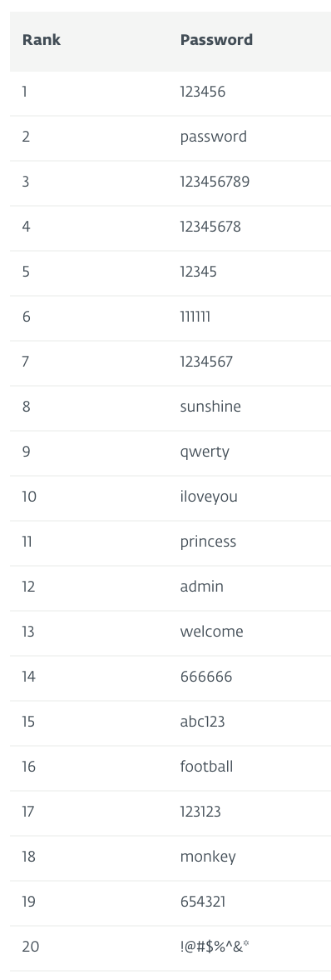
Use Strong Passwords
Use random characters. (Upper, lower, numbers, symbols)
The longer, the better.
Do not use personal info, like pet’s names or names of family members.
Do not use real words.
Notes:
Are you guilty of using common password? Here’s a list of the top 20 most popular (and most easily hacked passwords). Also some suggestions for creating strong passwords.

Slide 8
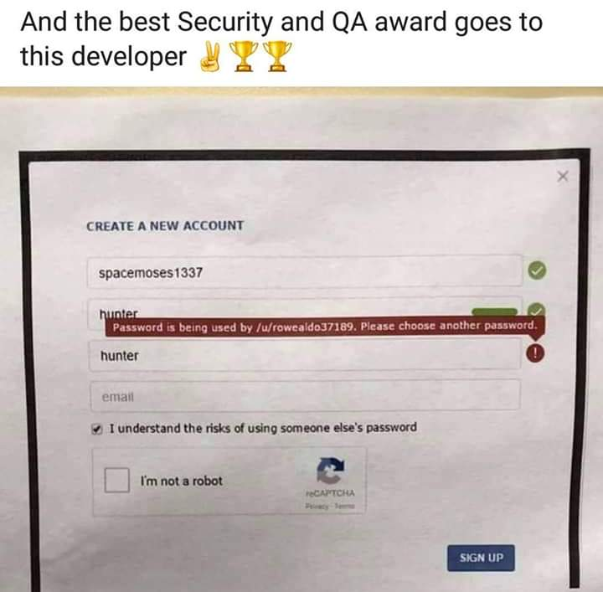
Don’t Share Your Password
Notes:
Do not share your password. And as developers, you should NEVER alert the user that their password is already in use by another user and then share the username of that user :)

Slide 9
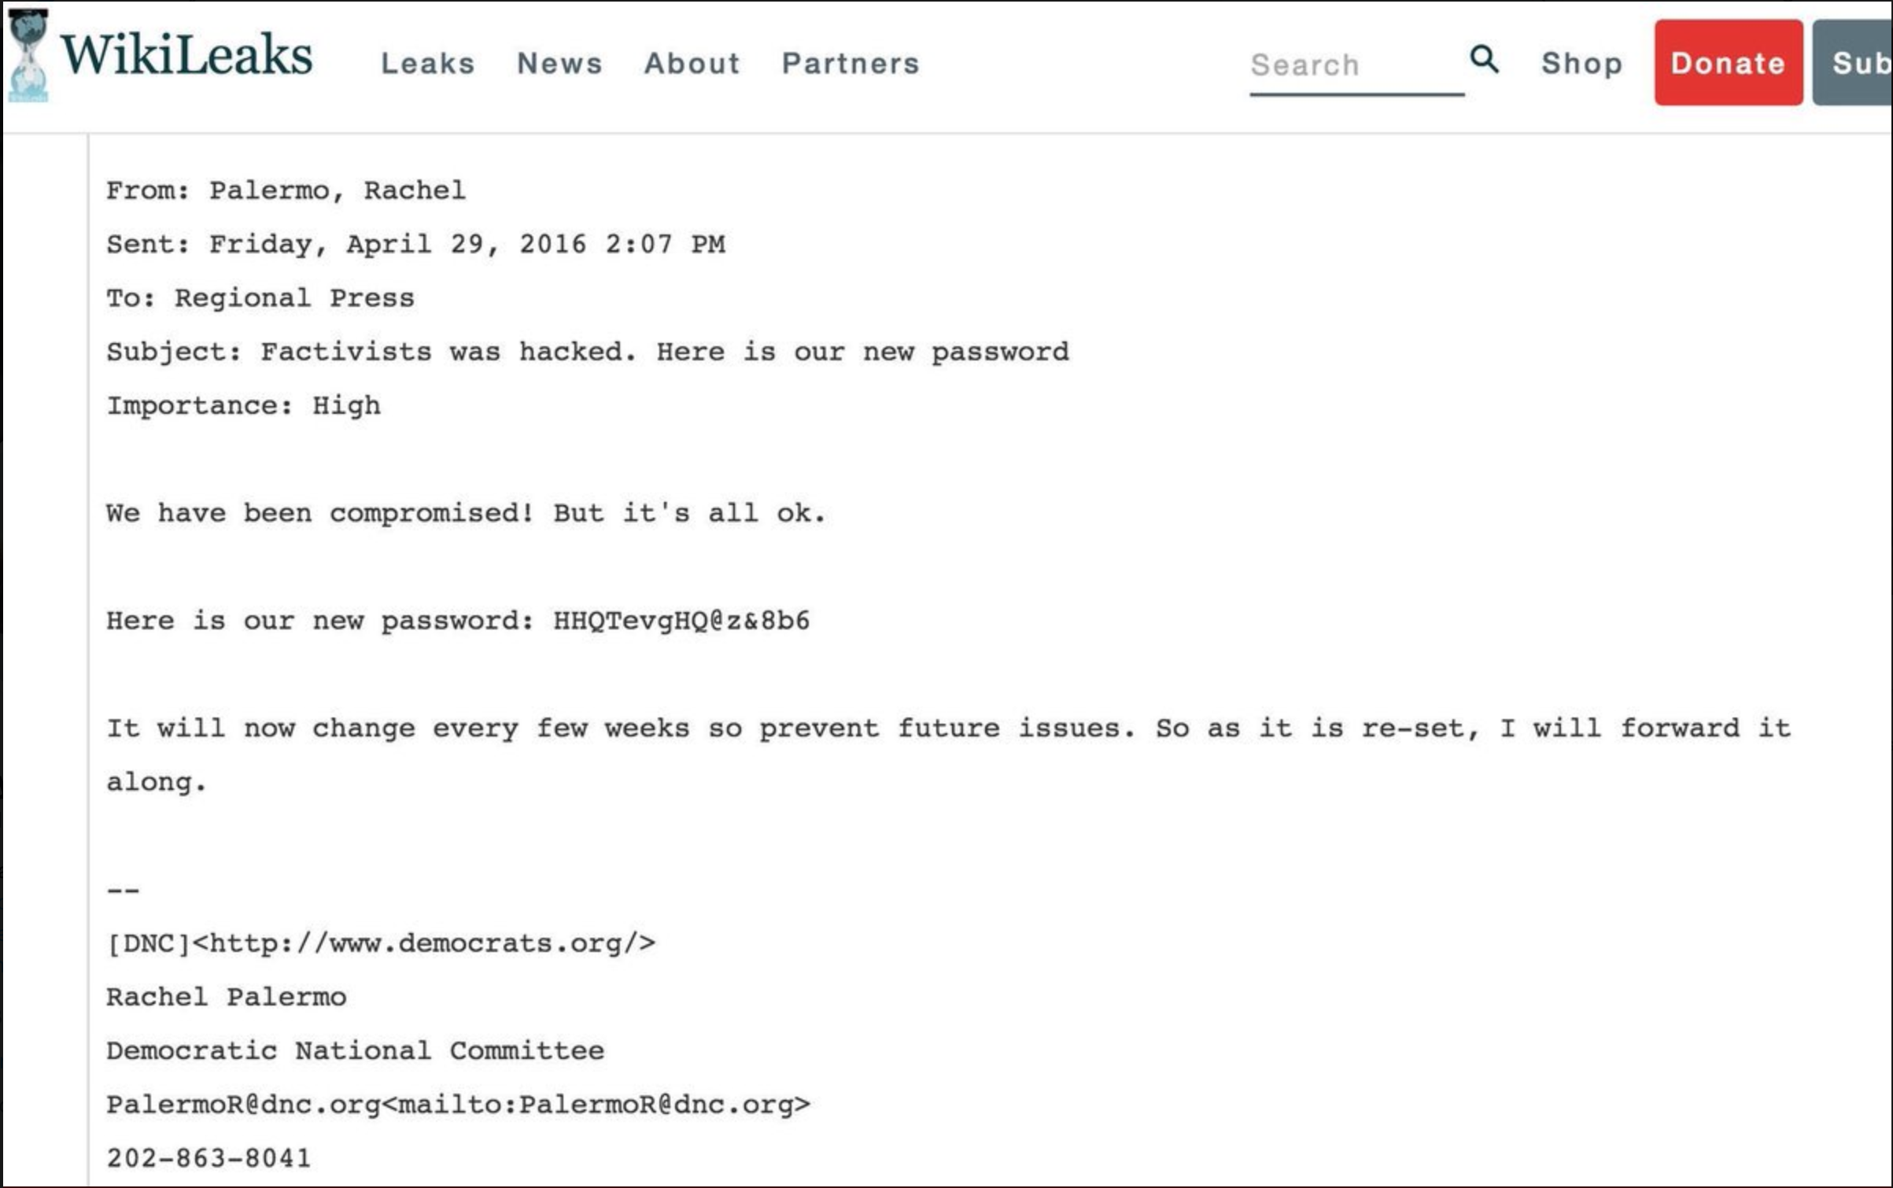
Don’t Share Your Password
Notes:
Again, bad things can happen when you share your password. See anything wrong with this email?
“Our server was hacked, but it’s all good. I’ll just send a new password to everyone from the server that was hacked!”
And I love how they say they will change the password every few weeks and will forward it along. *sigh*

Slide 10
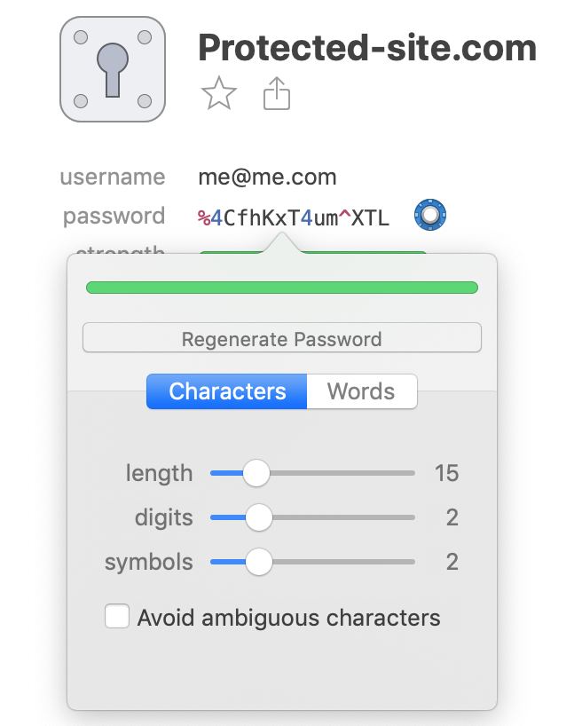
Consider A Password Manager
Only have to remember one password: the password to access your manager.
Can generate passwords for you.
Auto fill or copy/paste passwords without revealing the text to others who may be able to view your screen.
Prevents phishing.
Can sync across many devices.
Notes:
How many of you use a password manager? You all should! Most cost from $12 - $36/yr on a subscription now. But they offer some nice features and protection. With a password manager, you only need to remember 1 password and you easily maintain strong passwords on every site you visit.

Slide 11
Use Multi Factor Authentication
Something you know: (Password, PIN, KBA’s, etc.)
Something you have: (Mobile phone, USB Key, Bracelet, etc.)
Something you are*: (Finger print, voice detection, facial recognition, etc.)
Notes:
Use MFA, when it’s offered. MFA = multi factor authentication. Those factors include “Something you know” (like a password, PIN, knowledge-based authentication like “What was your high school mascot? What street did you grow up on? What was the first musical instrument you played?”)
“Something you have”, like responding to an SMS code, mobile alert, a physical USB hardware key, a special bracelet or QR code.
And more frequently now they are also including “Something you are”, like voice detection, facial recognition, fingerprint readers, eye scanners, etc.

Slide 12
Developers: Our Job To Protect User Data
Protect access to data physically.
Restrict access to data internally.
Store data safely and securely.
Notes:
Our job as developers is to protect the data the users give us.
First we need to physically protect the data. Data centers place their servers inside locked cages behind badge-key access doors. Access to these centers is highly controlled and entry points are reinforced.
Companies also restrict access to data internally, giving developers access to mock databases for development, storing API keys in virtual vaults, etc. and restrict access to their code repos and user logs to selected personnel.
We also need to store data safely and securely. For example… <next slide>

Slide 13
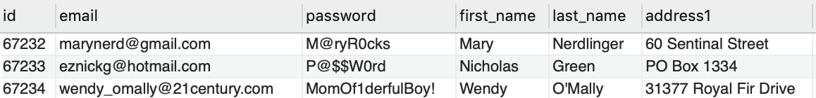
Our Super Secure Double Secret Database User Table:
Notes:
Here is our super secure double secret database user table…

Slide 14
Our Super Secure Double Secret Database User Table:
Anything wrong with this picture?
Notes:
Anything wrong with this picture?
The users all have strong passwords. They’re long, use mixed cases, contain symbols and numbers. So what’s wrong here?
The problem is… YOU CAN SEE THEM!! But it might surprise you (or maybe it won’t)…

Slide 15
Our Super Secure Double Secret Database User Table:
Anything wrong with this picture?
This is how Sony Pictures stored passwords in their database when they were hacked in 2009
Notes:
This is exactly how Sony Pictures stored millions of passwords when they were hacked in 2009.

Slide 16
Our Super Secure Double Secret Database User Table:
Anything wrong with this picture?
This is how Sony Pictures stored passwords in their database when they were hacked in 2009
The minute we store a user's password, we've taken on the responsibility of securing their password
Notes:
“The minute we store a user’s password, we’ve taken on the responsibility of securing their password.”
Let’s talk about how we can do that. <Hashing demo: https://github.com/mark-carlson/Password-Hashing-Demo>
(The demo shows how hashing algorithms have matured over time. The final demo is bcrypt, which is the currently accepted best practice way to hash passwords. You can demo salt rounds and how they work and how they future proof the library as hardware performance increases over time.)

Slide 17
Hashing Examples
Notes:
(The demo shows how hashing algorithms have matured over time. The final demo is bcrypt, which is the currently accepted best practice way to hash passwords. You can demo salt rounds and how they work and how they future proof the library as hardware performance increases over time.)

Slide 18
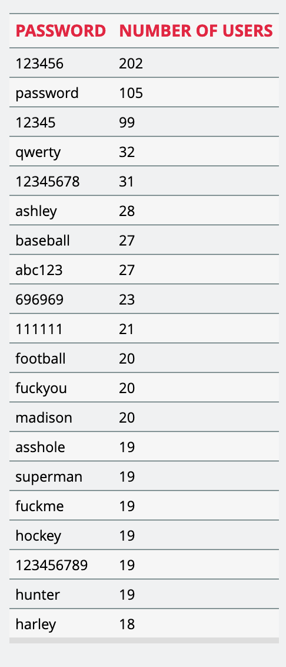
Use Strong Passwords
In August 2015, hackers released password data for 36 million accounts.
The company employed BCrypt encryption but…
Not all accounts were protected with BCrypt.
Of those that were, A security researcher could only crack 4000 of the weakest passwords.
Notes:
How many of you have heard of this company? Any account holders here?
In August 2015, hackers released account information for 36 million ashleymadison.com users. Fortunately the company employed bcrypt to secure most of their user’s passwords. But it wasn’t the release of the passwords that was so devastating. It was the email addresses. Families were torn apart, marriages were destroyed, and at least 2 suicides in Canada were tied to the release of this data.
A security researcher attempted to crack the passwords and after several weeks was only able to crack 4000 of the bcrypt encrypted passwords, and only because they were weak to begin with. (see list)
"Instead of cracking the slow bcrypt hashes directly, which is the hot topic at the moment, we took a more efficient approach and simply attacked the [MD5] tokens instead," the researchers wrote.
At the time of the team's posting, more than 11.2 million passwords had been successfully hacked, or about one-third of the total cache.
The moral of the story is… Use BCrypt for user authentication. And don’t have an affair!

